Slide 1
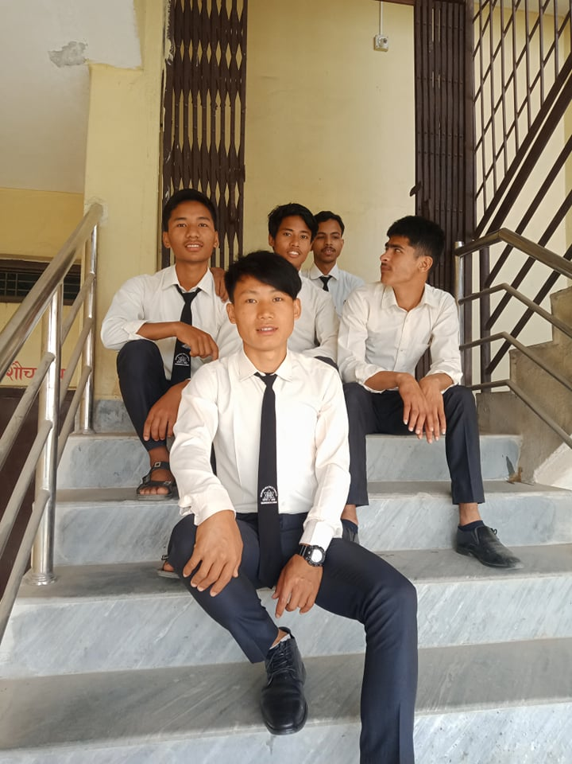
Socialization
Human being are social animal. They take a birth in a society. They live in society. The existence of individual can not be imagine out from society. Society is an aggregate of individual having common, culture, value, feeling of unity. All this cultures values and feeling of unity are the products of their struggle for existence struggle makes people successful.

Slide 2
Socialization is process by which individual can adjust in society. Socialization teaches social norms and values. Individual becomes cultural by the process of socialization. Socialize people can fulfill needs of daily life and develops habit to share pain and pleasure by logically we are organism but we become a social by the process of socialization.

Slide 3
Child Right
Children’s rights are human rights. Children must be treated with equality, respect and dignity, not because they are "the future" or the "adults of tomorrow", but because they are human beings today. All humans are born inherent with fundamental freedoms and rights.
Children must enjoy the same human rights as everybody else from the right to freedom of expression to the right to privacy. This means all human rights laws apply equally to children and adults.

Slide 4
However, children are afforded a low status in most societies. For example, in almost every country children under the age of 18 are denied political power because they cannot vote, and most countries allow parents to hit their children even though they would be prosecuted for assault if they hit an adult.

Slide 5
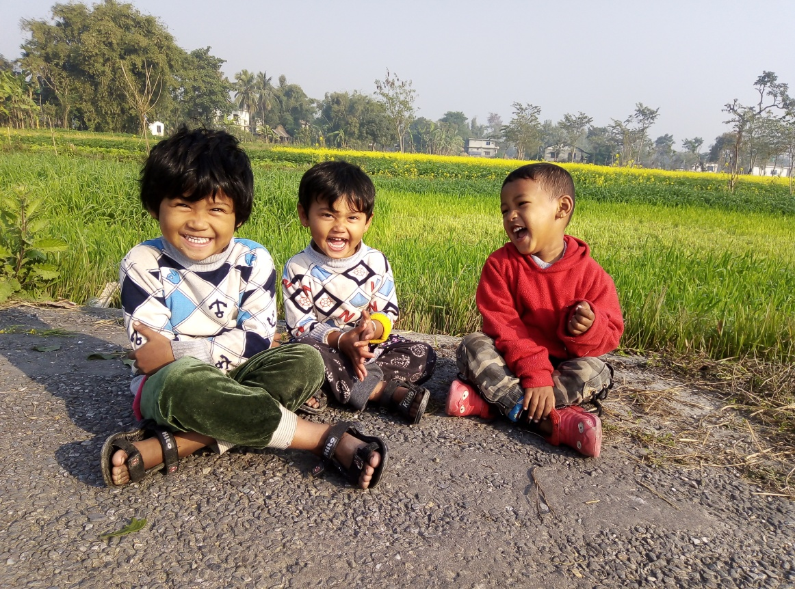
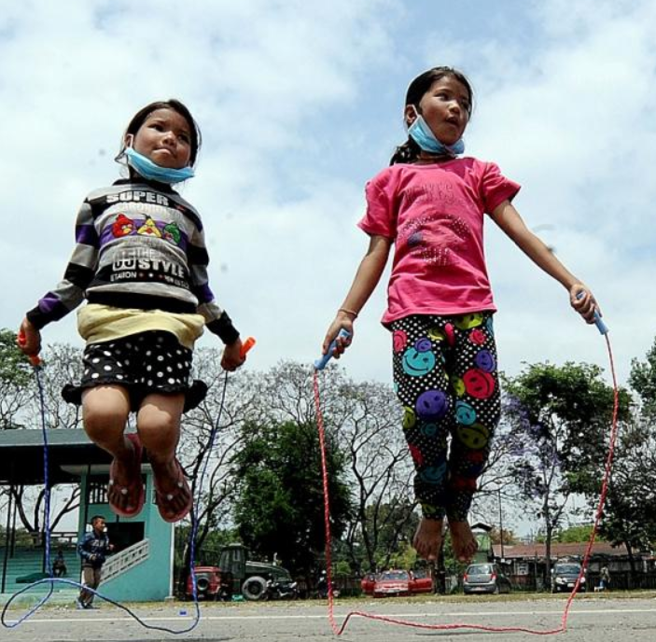

Slide 6
Children Rights
Right to live
Right to name, nationality and identity
Right to live and meet with the parents
Right to protection
Right to participate
Right to privacy etc.

Slide 7
Exit-1

